Slide 1
Module 3

Slide 2
Sequential Basics: Storage elements Counters[book 2], Sequential circuit timing : Propagation Delays, Setup, and Hold Times, Timing Conditions for Proper Operations, Glitches In Sequential Circuits, Synchronous Design. Tristate Logic and Busses [book 1].
Design flow of ASIC and FPGA based systems. Logic Synthesis, Synthesis Design Flow Coding guidelines[book1,2,3,6]

Slide 3
Sequential circuits are the mainstay of digital systems.
Sequential circuit elements that are widely used in digital systems for storing information and for counting events. We then see how a system can be built from two main sections: a data- path and a control section.
Discussion of a clocked synchronous timing methodology based on the abstraction of discrete time. This methodology is central to design of complex digital systems.

Slide 4
S TO R A GE EL EMEN TS
Sequential circuit as one whose outputs depend not only on the current values of inputs, but also on the previous values of inputs.
Sequential circuits are commonly regu- lated by a periodic clock signal that divides the passage of time into dis- crete clock cycles.

Slide 5
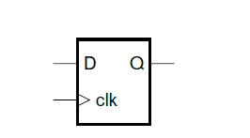
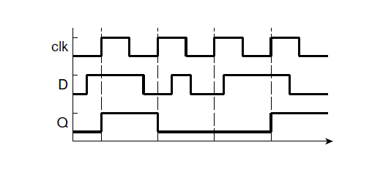
D Flip Flop
The flip-flop is edge-triggered, meaning that on each rising edge of the clk input, the current value of the D input is stored within the flip-flop and reflected on the Q output. We illustrated use of D flip-flops in sequential circuits in where we stored the previous two values of an input signal on successive clock edges so that we could detect a given sequence of input values.
While it is possible to implement a flip-flop as a combination of gates, it is not very instructive to do so. Moreover, flip-flops are provided as

Slide 6
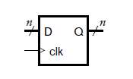
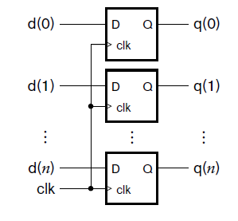
A group of flip-flops used in this way is called a register. Each flip-flop in the register stores one bit of the code word of the stored value, as shown in Figure . The circuit at the top of the figure shows that each bit of an input and an output signal is connected to the input and output, respectively, of one of the flip-flops, and that the clock signal is connected in common to the clock input of all of the flip-flops. When there is a rising edge on the clock input, each flip- flop in the register updates its stored bit from the signal connected to its data input and drives the new value on its data output. The symbol for the register is shown

Slide 7
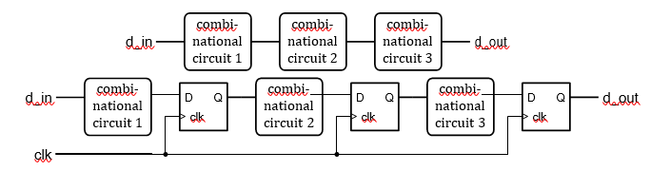
Circuit composed of combinational subcircuits (top), and a pipeline containing the same subcircuits.
One use for a register constructed from simple D flip-flops is as a pipeline register in a sequential design., focusing on the use of pipelining as a technique for improving performance of a digital system. For now, consider the circuit outlined at the top of Figure . Successive values of data arriving at the input are processed by a number of combinational subcircuits, for example, by arithmetic subcircuits built from components described in Chapter 3. The total propagation delay of the circuit is the sum of the propagation delays of the individual subcircuits. This total delay must be less than the interval between arriving data values, otherwise data values may be lost. If the total delay is too long, we can divide the circuit into segments by inserting a register after each subcircuit, as shown

Slide 8
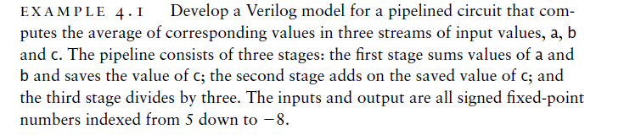
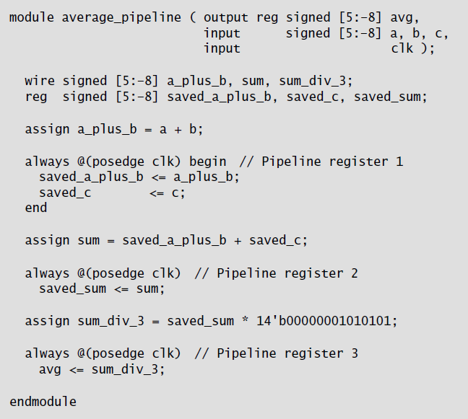

Slide 9
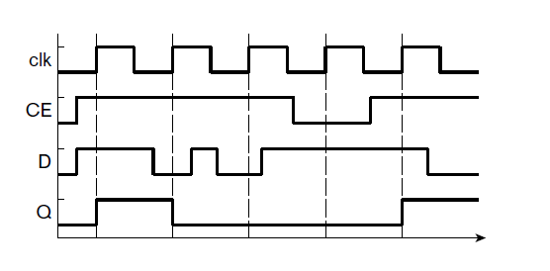
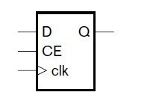
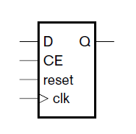

A D ﬂip-ﬂop with clock-enable input. With Timing Diagram
A D ﬂip-ﬂop with clock-enable and reset inputs.

Slide 10
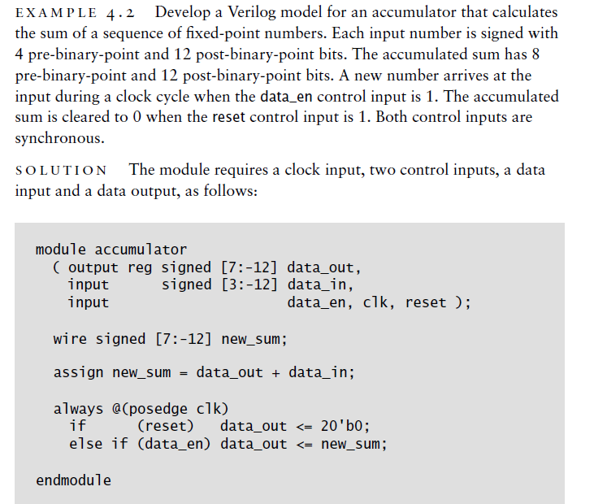

Slide 11
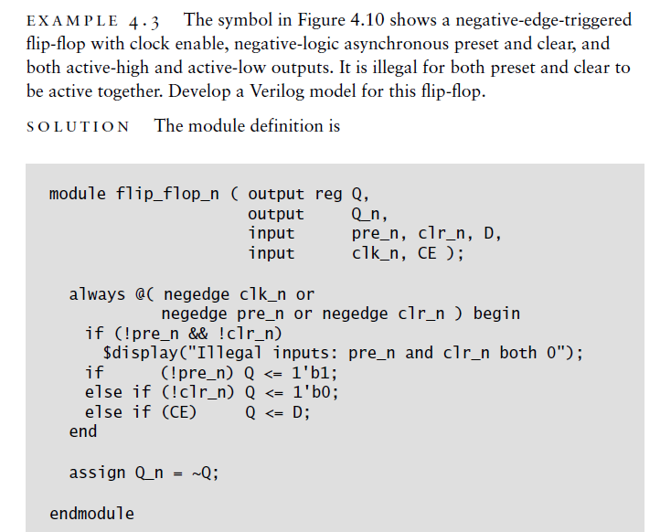

Slide 12
Shift Registers
. A shift register, on the other hand, can perform a shift operation on the stored data.
shift operation has the effect of scaling a numeric value by a power of 2.
shift operations are also used to implement serial transfer of data, that is, transfer one bit at a time over a single wire, instead of using separate wires for each of the bits of data
and combine arithmetic scaling with storage functions.

Slide 13
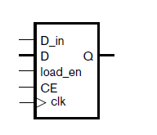
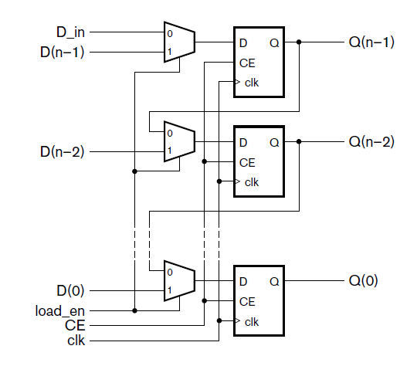

Slide 14
shows how it can be implemented with D flip-flops and multiplexers.
The shift register is updated on a rising clock edge when CE is 1. In that case, when the load_en signal is 1, the multiplexers select new data on the D(n–1) through D(0) inputs for updating the register.
Alternatively, when CE is 1 and load_en is 0, the multiplexers select the existing data, shifted right by one place. The least significant bit is discarded, and the most significant bit is updated with the value of the D_in signal.
If we tie D_in to 0, the shift register performs a logical shift right operation on the stored data. Alternatively, if we connect the most significant output bit back to D_in, the shift register performs an arithmetic shift right operation.

Slide 15
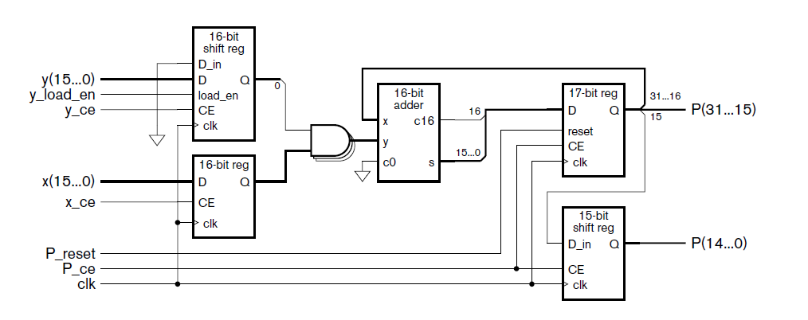
How to perform multiplication of unsigned integers by addition of partial products. Construct a multiplier for two 16-bit operands containing just one adder that adds successive partial products over successive clock cycles. The ﬁnal product is 32 bits.

Slide 16
solution In order to perform the operation over multiple cycles, we need a number of registers to hold intermediate results, as shown in Figure
The x operand is stored in an ordinary register whose output connects to an array of 16 AND gates that form a partial product. The y operand is stored in a shift register whose least significant bit, Q(0), controls the AND gates. The y operandis shifted on successive cycles, thus giving the 16 successive partial products. The sum of the partial products are accumulated in a 17-bit ordinary register and a 15-bit shift register. Since the shift register is never required to load data other than through the D_in connection, the data and load_en inputs are absent. On each clock cycle, the least significant bit of the ordinary register is shifted into the shift register, and the remaining bits of the ordinary register are added with the next partial product. By shifting the accumulated sum in this way, partial products are added at successively more significant positions of the result.

Slide 17
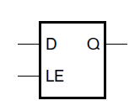
L ATC H E S
As we have seen, a flip-flop is a basic sequential circuit element that stores one bit. Most digital circuits use edge-triggered flip-flops that store a new data value when the clock signal changes from 0 to 1. No further values are stored while the clock remains at 1, nor when the clock returns to 0.
Some systems, however, use sequential elements called latches, with slightly different timing for storage of values. Figure shows a symbol for a latch, and Figure shows the timing behavior.

Slide 18
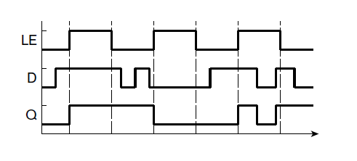

Slide 19
example 4.5 The following always block is intended to model multi- plexer circuitry that selects between a number of inputs to assign to outputs z1 and z2. Identify the error in the block and describe the behavior that results.
always @*
if (~sel) begin
z1 <= a1; z2 <= b1;
End
else begin
z1 <= a2; z3 <= b2;
end

Slide 20
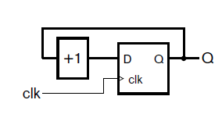
Counters
A counter is a sequential component that increments or decrements a stored value. Counters occur in many digital circuit applications. For example, if an application requires a given operation to be performed on
a number of items of data or to be repeated a number of times, a counter can be used to keep track of how many items have been processed or how many times the operation has been performed. Counters are also used as timers, by counting the number of intervals of a fixed duration that have passed.
A simple form of counter is composed of an edge-triggered register counter composed of a register and an incrementer. and an incrementer, as shown in Figure .

Slide 21
The value stored in the reg ister is interpreted as an unsigned binary integer. The incrementer can be implemented using the circuit we described for an unsigned incrementer. The counter increments the stored value on every clock edge. When the stored count value reaches its maximum value (2n — 1, for an n-bit counter), the incrementer yields a result of all zeros,with the carry out being ignored. This result value is stored on the next clock edge.
Thus, the counter acts like the odometer in a car, rolling over to zeros after reaching its maximum value. Mathematically speaking, the counter increments modulo 2n. The counter goes through all 2n unsigned binary integer values in order every 2n clock cycles. One use for such a counter is in conjunction with a decoder to produce periodic control signals.

Slide 22
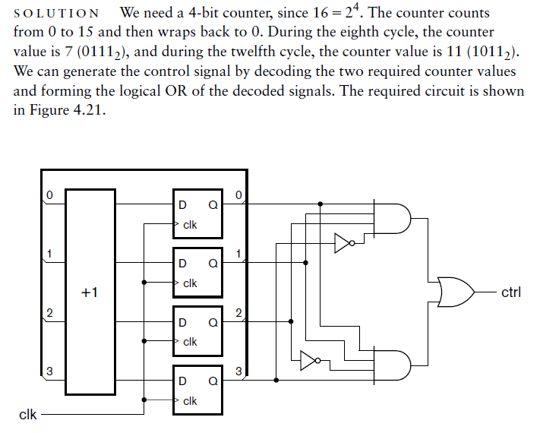
Design a circuit that counts 16 clock cycles and produces a control signal, ctrl, that is 1 during every eighth and twelfth cycle.

Slide 23
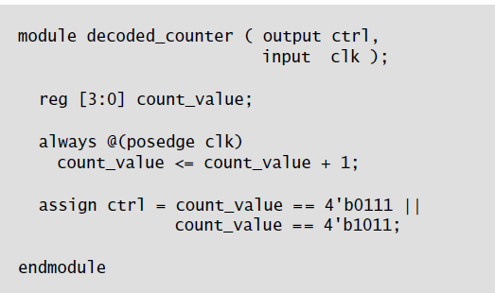
Develop a Verilog model of the circuit for previous example

Slide 24
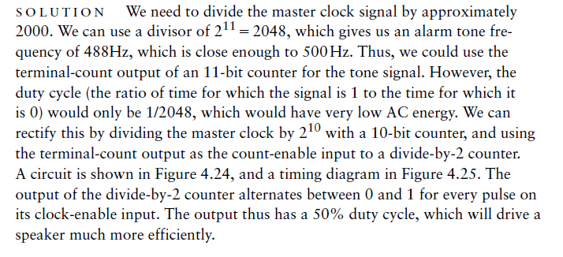
A digital alarm clock needs to generate a periodic signal at a frequency of approximately 500Hz to drive the speaker for the alarm tone. Use a counter to divide the system’s master clock signal, with a frequency of 1 MHz, to derive the alarm tone.

Slide 25
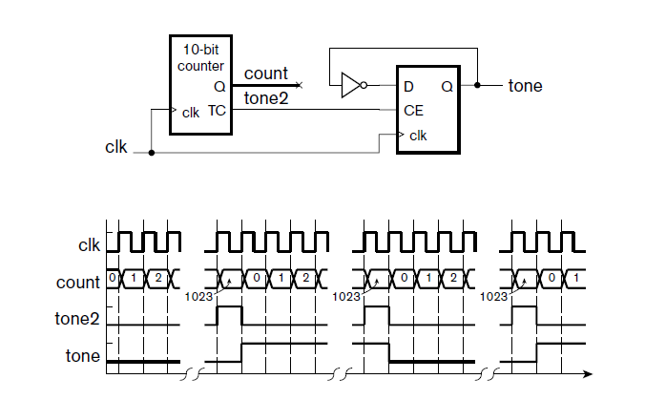

Slide 26
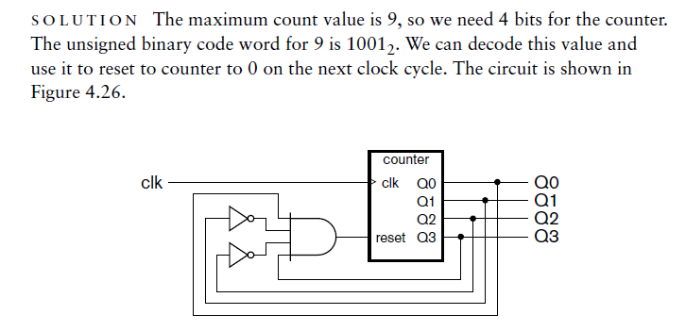
Design a circuit for a modulo 10 counter, otherwise known as a decade counter.

Slide 27
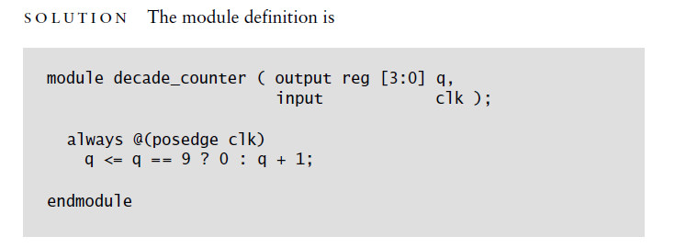
Develop a Verilog model for the decade counter of previous Example

Slide 28
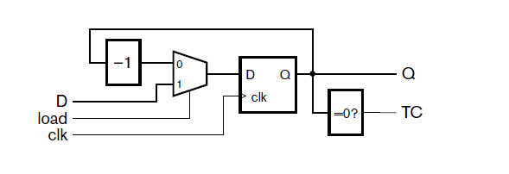
Another form of counter that is useful in timing applications is a down counter with load. This counter is loaded with an input value, and then decrements the count value. The terminal count output is activated when the count value reaches zero. A circuit for the counter is shown in Figure

Slide 29
If the clock input to the counter is a periodic signal with period t and the counter is loaded with a value k, the terminal count is reached after an interval of k × t. Thus, this form of counter can be used as an interval timer, where the terminal-count output signal is used to trigger an activity after expiration of a given time interval.

Slide 30
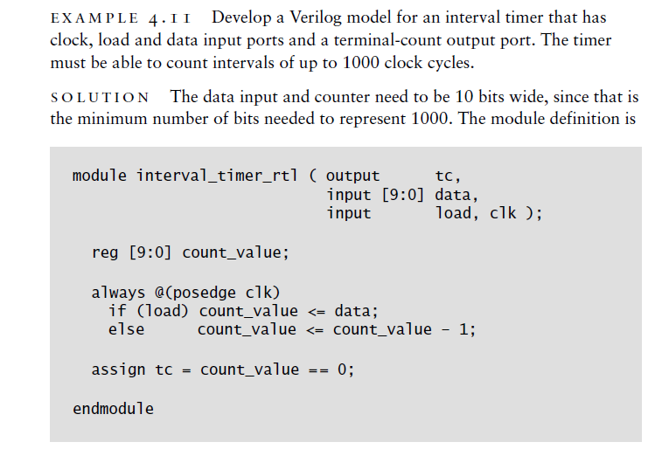

Slide 31
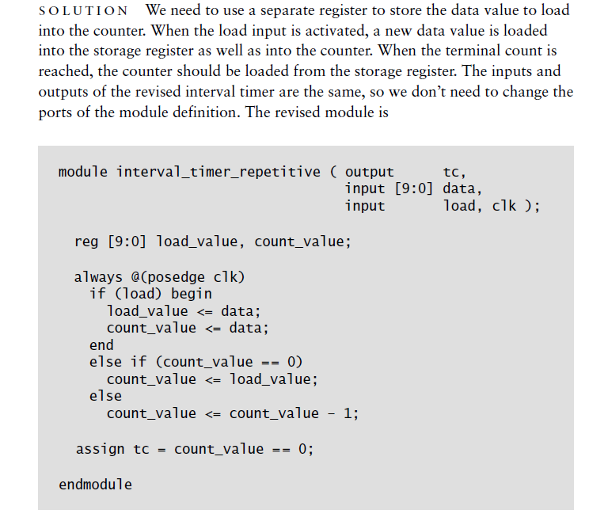
Modify the interval timer so that, when it reaches zero, it reloads the previously loaded value rather than wrapping around to the largest count value.

Slide 32
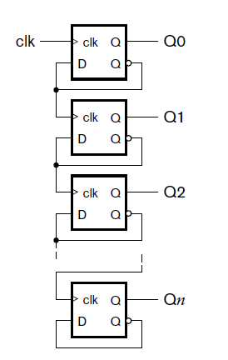
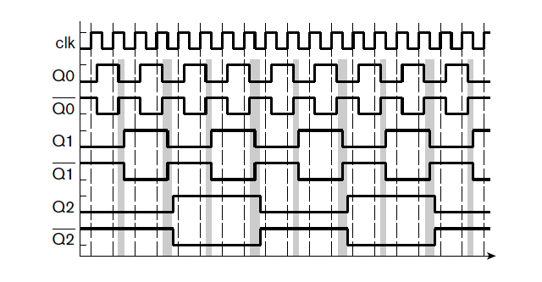
Ripple Counter

Slide 33
The last kind of counter that we will describe in this section is a ripple counter (distinct from ripple carry used in an incrementer of a counter), shown in Figure. It is somewhat different in structure from the syn- chronous counters we have previously examined. Like those counters, it has a collection of flip-flops for storing the count value. However, unlike them, the clock signal is not connected in common to all of the flip-flop clock inputs. Rather, the clock input just triggers the flip-flop for the least significant bit, causing it to toggle between 0 _and 1 on each rising clock edge. When the Q output changes to 0, the Q output changes to 1, triggering the next flip-flop to toggle between 0 and 1. This flip-flop behaves similarly….

Slide 34
Sequential Circuit Timing
The correct functioning of sequential circuits involves several timing issues. Propagation delays of flip‑flops,
gates and wires;
setup times and
hold times of flip‑flops;
clock synchronization;
clock skew;

Slide 35
Propagation Delays, Setup, and Hold Times
There is a certain amount of time, albeit small, that elapses from the time the clock changes to the time the Q output changes. This time, called propagation delay or clock-to-Q delay of the flip‑flop is indicated in Figure 1‑34. The propagation delay can depend on whether the output is changing from high to low or vice versa. In the figure, the propagation delay for a low‑to‑high change in Q is denoted by tplh, and for a high‑to‑low change it is denoted by tphl.
For an ideal D flip‑flop, if the D input changed at exactly the same time as the active edge of the clock, the flip‑flop would operate correctly. However, for a real flip‑ flop, the D input must be stable for a certain amount of time before the active edge of the clock. This interval is called the setup time (tsu). Furthermore, D must be stable for a certain amount of time after the active edge of the clock. This interval is called the hold time (th). Figure 1‑34 illustrates setup and hold times for a D flip‑flop that changes state on the rising edge of the clock. D can change at any time during the shaded region on the diagram, but it must be stable during the time interval tsu before the active edge and for th after the active edge. If D changes at any time during the forbidden interval, it cannot be determined whether the flip‑flop will change state. Even worse, the flip‑ flop may malfunction and output a short pulse or even go into oscillation.

Slide 36
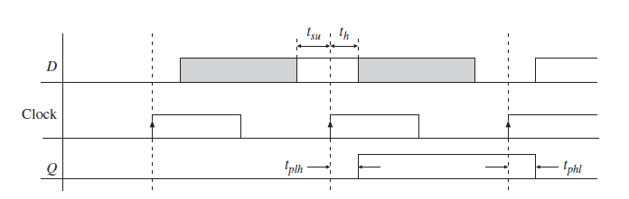
Flip‑flops typically have a setup time about 3–10x of the propagation delay of an inverter (NOT) gate. The hold times are typically 1–2x of the delay of an inverter. Minimum values for tsu and th and maximum values for tplh and tphl can be obtained from manufacturers’ data sheets or ASIC (Application Specific Integrated Circuit) libraries accompanying design tools.

Slide 37
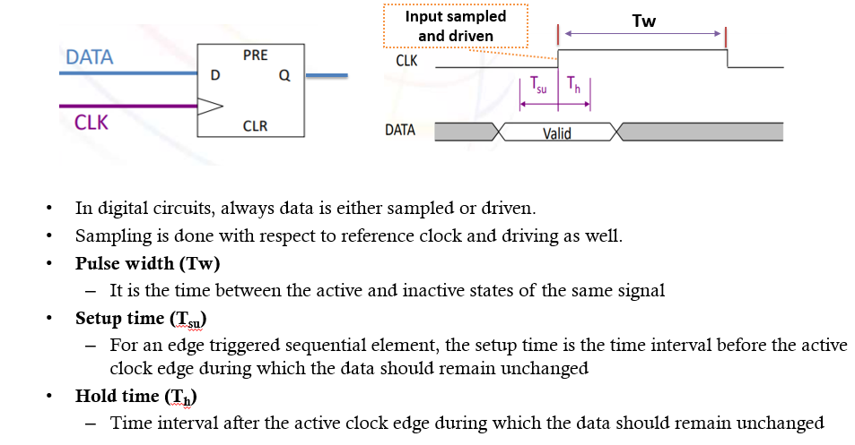
Set up and Hold Time

Slide 38
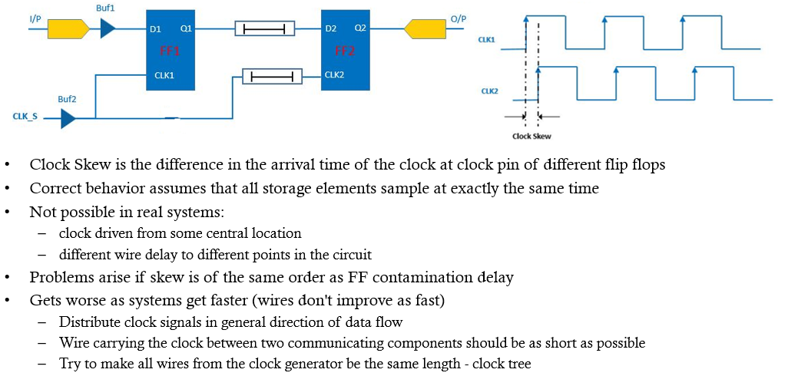
Clock skew

Slide 39
Timing Conditions for Proper Operation
In a synchronous sequential circuit, state changes occur immediately following the active edge of the clock.
The maximum clock frequency for a sequential cir‑ cuit depends on several factors.
The clock period must be long enough so that all flip‑flop and register inputs will have time to stabilize before the next active edge of the clock.
Propagation delays and setup and hold times create complications in sequential circuit timing.

Slide 40
Static timing analysis (STA) is a method of validating the timing performance of a design by checking all possible paths for timing violations under worst‑case conditions. A static analysis path starts at a source flip‑flop (or at a primary input) and terminates at a destination flip‑flop (or primary output). A static timing path between two flip‑flops starts at the input to the source flip‑flop and terminates at the input of the destination flip‑flop. It does not go through the destination flip‑ flop. The path terminates when it encounters a clocked device. If a signal goes from register (flip‑flop) A to register B and then to register C, the signal contains two paths. The timing paths in a synchronous digital system can be classified into 4 types:
Register to register paths (i.e., flip‑flop to flip‑flop)
Primary input to register paths (i.e., input to flip‑flop)
Register to primary output paths (i.e., flip‑flop to output)
Input to output paths (i.e., no flip‑flop)

Slide 41
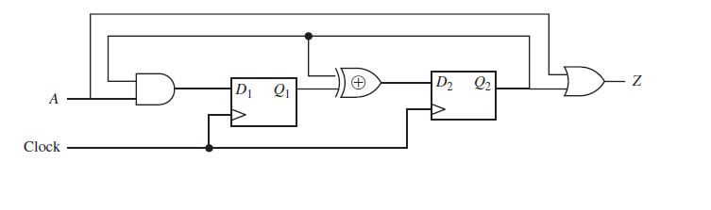
There are six static timing paths in this circuit:
From A to D1 (primary input to flip‑flop)
From D1 to D2 including the XOR (flip‑flop to flip‑flop)
From D2 via XOR to D2 (flip‑flop to flip‑flop)
From D2 to D1 via AND (flip‑flop to flip‑flop)
From D2 to Z via the OR gate (flip‑flop to output)
From A to Z via the OR gate (input to output)
The most complicated paths are the flip‑flop to flip‑flop paths; the other paths can be treated as special cases of this type of path.
Static timing analysis checks how the data arrives with respect to clock. It detects setup and hold‑time violations in the design so that they can be corrected. A setup time violation occurs if the data changes just before the clock without pro‑ viding enough setup time for the flip‑flop. A hold-time violation occurs if the data changes just after the clock without providing enough hold time for the flip‑flop.

Slide 42
Slack is the amount of time still left before a signal will violate a setup or hold‑time constraint. Paths must have a positive or zero slack in order to have no violations. Paths that have a zero or very small slack are the speed‑limiting paths in the design, because any small changes in clock or gate delays will lead to violations in such circuits. Paths that have a negative slack time have already violated a setup or hold constraint. Static timing analysis considers the worst possible timing scenarios, but not the logical operation of the circuit. In comparison with circuit simulation,
static timing analysis is faster because it doesn’t need to simulate multiple test vectors.

Slide 43
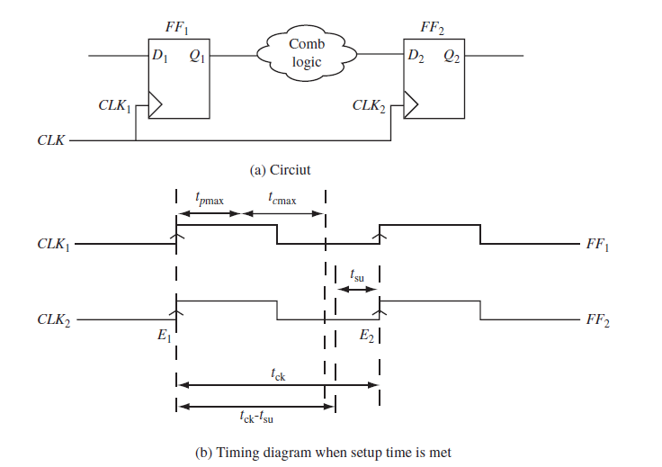
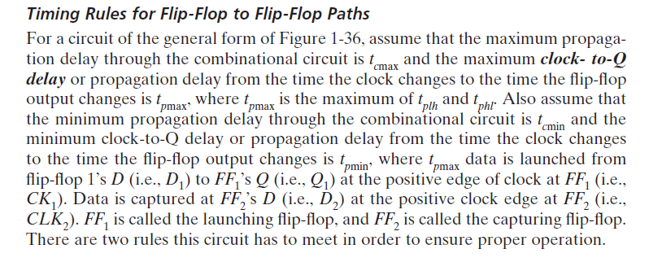

Slide 44
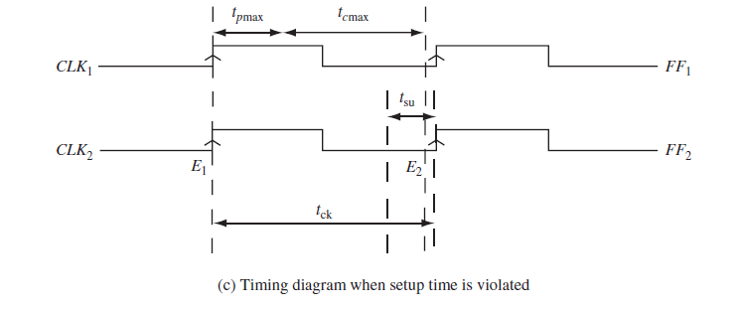
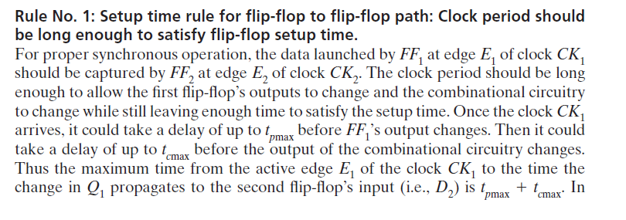

Slide 45
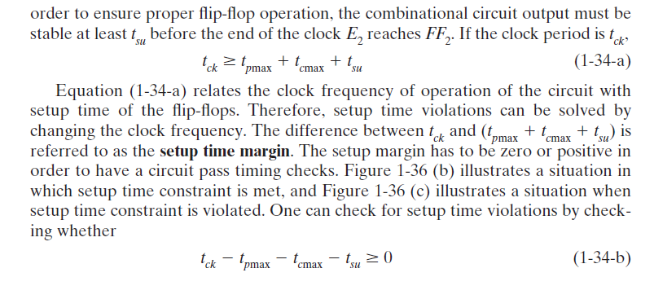

Slide 46
